Slide 1
Myo Armband
By Thalmic
https://www.youtube.com/watch?v=te1RBQQlHz4

Slide 2
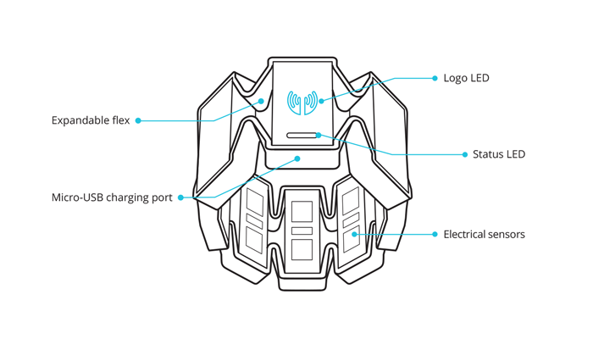
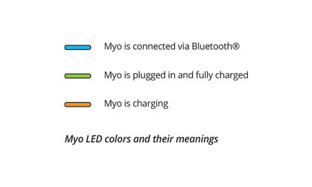
The Hardware

Slide 3
What is it
Sensors
Medical Grade Stainless Steel EMG sensors
Highly sensitive nine-axis IMU containing
three-axis gyroscope
three-axis accelerometer
three-axis magnetometer
Communicates by Bluetooth 4.0 low energy
Compatible with most devices, some limitations on OS
Full Details here
https://www.myo.com/techspecs

Slide 4
Developers View
Two types of data
Spatial and Gestural
Spatial Data
Orientation and movement of the user’s arm
Two kinds of spatial data
Orientation – which way is the Myo pointed?
Provided as a quaternion that can be converted to other representations like rotation matrix or Euler angles (yikes)
Acceleration vector – acceleration the Myo is undergoing at any given time
Provided as a 3D vector

Slide 5
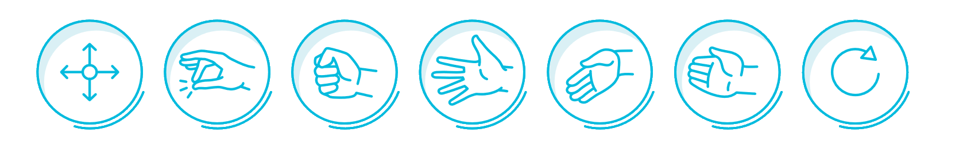
Developers View
Gestural Data
What is the use doing with their hands
One of several preset poses (configurations)
Information about which arm and orientation
Determined with the Sync gesture at start
Positive X-axis facing either wrist or elbow

Slide 6
Developers View
Feedback
Using vibration command
Causes armband to vibrate in a what that is audible and sensed through touch
Bluetooth driver comes with SDK
Need to install Myo Connect for set up and testing of the Myo
https://developer.thalmic.com/downloads
SDK available for Windoiws, MAC and Android
Includes support for Unity
Built-in capabilities to control certain presentation and media applications on Windows and Mac OS X
Powerpoint, prezi
Guide available
Try them out, see how they work

